Slide 1
SSW-555: Agile Methods for Software Development
Spotify Case Study
Instructor: Dr. Nafiseh Ghorbani
Department of Systems and Enterprises
Stevens Institute of Technology

Slide 2
Acknowledgements
Some of the material in these slides is from:
C. Ebert and M. Paasivaara, "Scaling Agile," in IEEE Software, vol. 34, no. 6, pp. 98-103, November/December 2017, doi: 10.1109/MS.2017.4121226.
Henrik Kniberg. (2017, February 27). Spotify Engineering Culture Part 2 [Video file]. Retrieved from https://youtu.be/vOt4BbWLWQw

Slide 3
Today's topics
Overview of Spotify music streaming
Compare and contrast Spotify streaming service implementation of Agile vs. Scrum and XP
Access Spotify’s release management process

Slide 4
Takeaways from video 1
As you listen, consider the following:
How is the Spotify process unique?
Does the structure facilitate communication?
Are there missing roles?
Reflection
How does Spotify’s implementation of Agile differ from XP, Scrum, etc.? What characteristics are similar?

Slide 5
Takeaways from video 2
As you listen, consider the following:
Do you think hack time develops creativity?
How does Spotify balance growth with structure?
Hack time refers to informal or experimental coding outside regular tasks.
Involves exploratory programming or prototyping new ideas.
Can be for personal projects, learning, or side experiments.
Some companies allocate hack time for innovation and creativity.
Reflection
What are the risks to the application and business with releasing unfinished code?

Slide 6
Takeaways from Lecture Slides
As you listen, consider the following:
How does Spotify handle code not ready for production?
How does Spotify release new features?
Reflection
How does Spotify promote creativity? Do you think they do enough?

Slide 7

Overview
In this lecture, we will discuss Spotify music streaming service and how it implemented a unique Agile methodology.
Spotify is a music streaming service that offers paid and free versions.
In the third quarter of 2021, Spotify reported 381 million active users worldwide, with 172 million premium subscribers worldwide.
Spotify has over 5,500 (2020) developers working on the Spotify products, with 70+ squads across 5 cities. Spotify developers do not follow a single Agile method.
They began with Scrum, but found that it “got in the way,” so they built a unique development process.

Slide 8
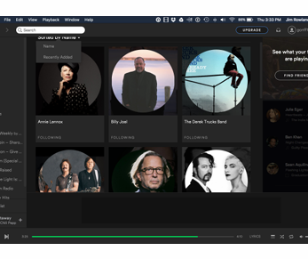
Spotify: Music Streaming Service
Freemium model
Basic account is free with ads
Premium accounts cost money
History
2006: company founded in Sweden
2008: service launched in Europe
2011: launched in US
Platforms
Desktop (Windows, Mac, Linux)
Mobile (IOS, Android)

Slide 9
Agile practices at Spotify
5500+ developers working on the Spotify product (2020)
70+ squads across 5 cities (2015)
Spotify developers do not follow a single Agile method
Began with Scrum but found that it “got in the way”
Agile > Scrum
Principles > Practices
Each development group chooses methods that work for them
e.g. Scrum, Kanban, Lean, …

Slide 10
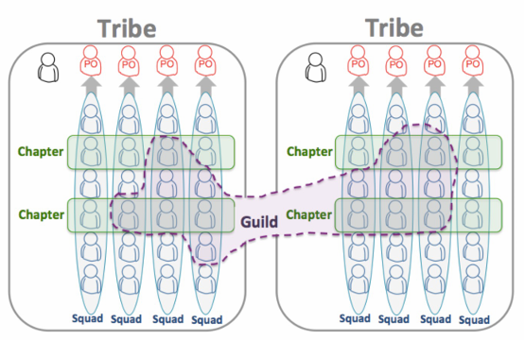
Spotify organizational structure
Squads
Small teams: <= 8 people
Tribes
Collections of squads
Chapters
Groups within a tribe that share a specialty or responsibility
Guilds
Cross-tribe communities of interest

Slide 11
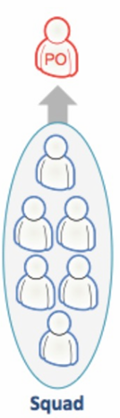
Squad
Small, autonomous, agile teams
Loosely coupled, but tightly aligned
One long-term mission
End to end responsibility: develop, test, deploy, maintain…
E.g. IOS client, Android Client, DB backend, …
Self organizing
Choose their own methods and procedures
Each squad may use a different approach

Slide 12
Squad
A Squad is a small, cross-functional, Agile team.
Focuses on specific features or product areas.
Operates autonomously, using Agile practices (Scrum/Kanban).
Includes roles like developers, designers, and product owners.
Delivers end-to-end product functionality.
Emphasizes innovation, speed, and autonomy.

Slide 13
Squad Roles
No formal leader
Product owner
Prioritizes work from backlog
Collaborates with other product owners to coordinate between squads
Squads interact through Product Owners
Agile coach
Agile coach may work with multiple squads
Help to run meetings, retrospectives, sprint planning
Help squads with Agile processes

Slide 14
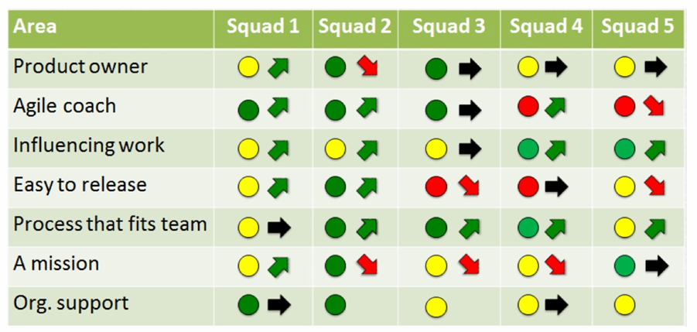
Quarterly Reflection Survey
Each squad conducts a quarterly survey to reflect on what’s working and not working well and the trends

Slide 15
Quarterly Reflection Survey
Parking Lot Chart: Being used to visualize and categorize feedback or reflections on different aspects of the work.
The Parking Lot Chart helps in visually organizing issues, insights, or themes discussed during the reflection period. Here's what the typical circle colors and arrows might represent:

Slide 16
Quarterly Reflection Survey
The colors of the circles in a Parking Lot Chart generally signify different categories or themes that emerged from the reflections or survey responses.
These categories might relate to various aspects of the agile process, such as team dynamics, process improvements, or project health.
Green Circle: Positive feedback or successful elements. This might represent things that are working well, such as good collaboration, well-executed features, or positive team dynamics.
Yellow Circle: Neutral or areas that need attention. This could indicate areas where things are neither going well nor badly. For example, teams might be uncertain about a process or feature that’s showing mixed results.
Red Circle: Challenges or negative feedback. Red often indicates problems, obstacles, or areas needing improvement, such as missed deadlines, low morale, or technical debt.

Slide 17
Quarterly Reflection Survey
Arrows:
Arrows in a Parking Lot Chart are typically used to represent movement or change over time.
In the context of a Quarterly Reflection Survey, arrows can indicate trends, changes in feedback, or actions to be taken.
Upward Arrow: Represents improvement or progress. This could indicate that something has gotten better over the quarter, such as improvements in communication, collaboration, or the effectiveness of certain processes.
Downward Arrow: Represents deterioration or decline. This could point to areas that have worsened, such as dropping team morale or ineffective sprints.
Left/Right Arrow: Could represent no significant change or stability. If there’s no notable movement, this may indicate that a specific practice, team dynamic, or process remains steady.

Slide 18
Quarterly Reflection Survey
In Summary:
Circle Colors represent different categories of feedback or themes (e.g., green for positive, yellow for neutral, red for negative).
Arrows represent changes over time or actions to be taken in response to feedback, with upward arrows indicating improvement, downward arrows indicating challenges, and side arrows showing stability.
This chart helps teams quickly visualize what's working, what needs improvement, and where they should focus their efforts for the next quarter.

Slide 19
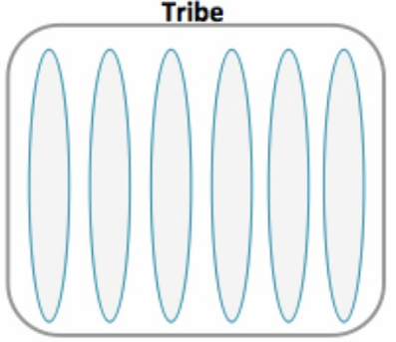
Tribe
A Tribe is a collection of related Squads working on similar areas or features.
Typically consists of multiple Squads that align around a common goal or product domain.
Led by a Tribe Lead to ensure coordination and alignment.
Promotes collaboration between Squads within the same Tribe.
Focuses on scaling Agile and maintaining consistency across teams.

Slide 20
Tribe
Collection of squads in related areas
≦~ 100 people
Physically co-located
May have a System Owner
Represents Product Owners across Tribe
May have a Chief Architect
Responsible for overall architecture and design across Tribe

Slide 21
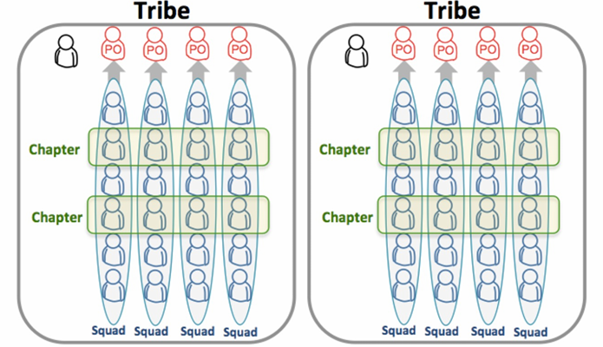
Chapter
A Chapter is a group of individuals with similar skills or roles (e.g., developers, designers) across different Squads.
Led by a Chapter Lead who focuses on career development and technical alignment.
Promotes knowledge sharing and best practices within the same discipline.
Ensures consistency in practices and standards across Squads.

Slide 22
Chapter
Take advantage of economies of scale without loss of autonomy
People with similar interests, e.g. testing, databases, etc…
Focus on competencies
Chapter lead is line manager

Slide 23
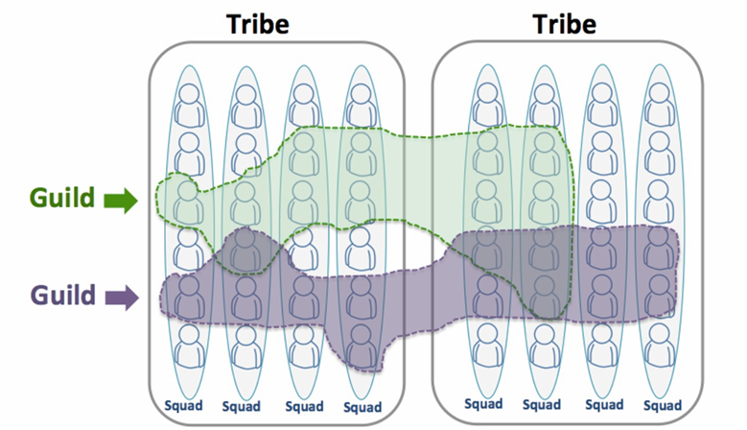
Guild – Community of Interest
A Guild is a community of people with shared interests or expertise across different Tribes and Squads.
It’s a voluntary group that focuses on knowledge sharing, learning, and innovation.
Members may come from different disciplines (e.g., backend, frontend, data science).
Led by Guild Coordinators, not managers, to foster collaboration.
Promotes cross-team collaboration and continuous improvement in specific areas of interest.

Slide 24
Guild – Community of Interest
Guild members share a common interest and share information
e.g. database technology, processes, etc.
Birds of a Feather (BOF) groups

Slide 25
System Owner
A large, complex system requires technical oversight to ensure technical integrity
Need an overall architecture
Each major system has a System Owner
System Owner coordinates decisions about the system
Owns quality, documentation, technical debt, reliability, scalability, etc.
Part time responsibility along with development

Slide 26
Chief Architect
Responsible for high-level architecture across multiple systems
Review new development for integrity and alignment
Offers advice – squad is ultimately responsible

Slide 27
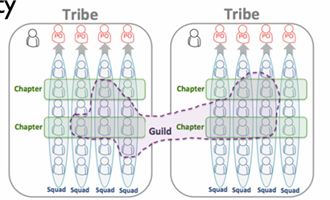
Summary of organizational structure
Squads
Focus on product delivery and quality
Tribes
Lightweight matrix
Chapter
Competency area
E.g. Agile Methods, web development, …
Chapter Leader is the line manager
Guild
Lightweight community of interest across the company
Flexible membership

Slide 28
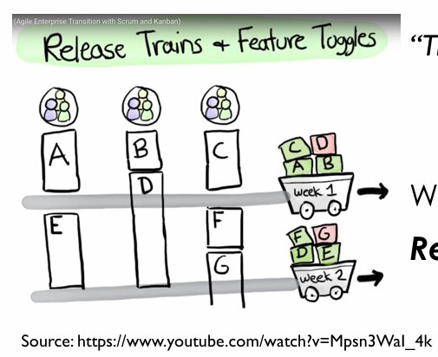
Release Management at Spotify
“Think it, build it, ship it, tweak it”
Focus on frequent releases with user feedback to choose best alternative
Weekly releases to production
Release early and often

Slide 29
Release Management at Spotify
Agile Release Trains
Each squad makes their own releases without central control
All complete features and some incomplete features
Incomplete features are not visible to users through Feature Toggles
Identifies integration issues early
New features are rolled out to few users at a time until proven
Limited blast radius

Slide 30
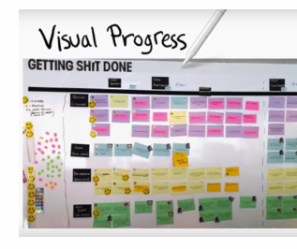
Practices at Spotify
Agile Release Trains
Visualize progress, e.g. Kanban
Weekly demos/Story Telling
Daily sync (stand up meetings)
Break big projects into small projects with frequent releases
Boot camp
Hack Time

Slide 31
Practices at Spotify
Hack Time
Boot Camp
Hack time refers to informal or experimental coding outside regular tasks.
Involves exploratory programming or prototyping new ideas.
Can be for personal projects, learning, or side experiments.
Some companies allocate hack time for innovation and creativity.
Intensive training programs focused on teaching coding and software development skills.
Typically short-term (ranging from a few weeks to a few months).
Designed for beginners or those looking to switch careers into tech.
Emphasize hands-on learning with real-world projects.
Cover key topics like web development, data structures, algorithms, and programming languages (e.g., JavaScript, Python).
Often include job placement assistance or career support.
Aimed at preparing students for junior developer roles quickly.

Slide 32
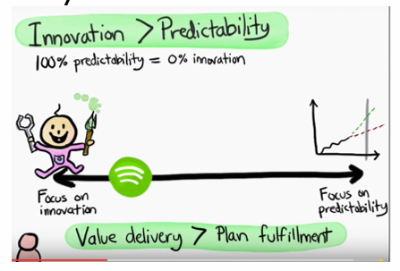
Spotify Strategies
Emphasis on culture
“Healthy Culture heals Broken Process”
Eliminate waste
Balance between chaos and bureaucracy
Emphasis on innovation
Trade innovation for predictability
Experiment-friendly culture
Limited Blast Radius of failure
Gradual rollout with feature toggles
Fail Fast, Learn Fast, Improve Fast

Slide 33
Takeaways from Lecture Slides
As you listen, consider the following:
How does Spotify handle code not ready for production?
How does Spotify release new features?
Reflection
How does Spotify promote creativity? Do you think they do enough?

Slide 34

Questions?

